Slide 1

Animated Film Success
What are the most influential factors?
Sarah Theriot

Slide 2
Statistical Question/Hypothesis
What are the factors that most influence the box office success of a Disney animated film?
Do female-led films perform better than male-led films?

Slide 3
Datasets
For this analysis we will be using multiple datasets that have many potentially influential variables. After merging the datasets, these are the variables we are looking at.
Inflation Adjusted Gross Dataset:
Movie Title: movie_title
Inflation Adjusted Gross: inflation_adjusted_gross
Runtime:
Movie Title: title
Budget: Budget
Runtime: Running time
Movie Ratings:
Movie Title: film_title
IMDB Rating: imdb_score
Rotten Tomatoes Rating: rotten_tomatoes
Characters
Movie Title: movie_title
Hero’s Gender: hero_gender

Slide 4
‘Inflation Adjusted Gross’ Descriptive Statistics
Descriptive Statistics:
count 4.600000e+01
mean 3.483875e+08
std 2.407007e+08
min 5.518914e+07
25% 1.933303e+08
50% 2.791356e+08
75% 4.352262e+08
max 9.206087e+08
Name: inflation_adjusted_gross, dtype: float64

Slide 5
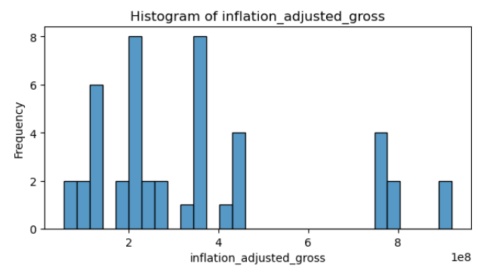
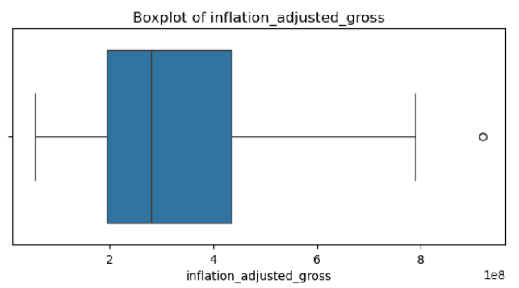
‘Inflation Adjusted Gross’ Visualizations
Note: The outlier indicates that there was a movie that did substantially better than most.

Slide 6
‘Budget’ Descriptive Statistics
Descriptive Statistics:
count 46.000000
mean 89.973913
std 59.582210
min 2.900000
25% 45.000000
50% 90.000000
75% 125.000000
max 260.000000
Name: Budget, dtype: float64

Slide 7
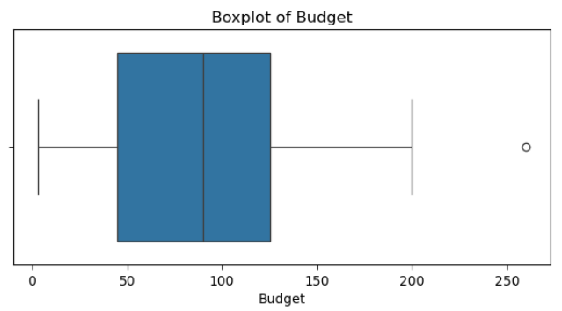
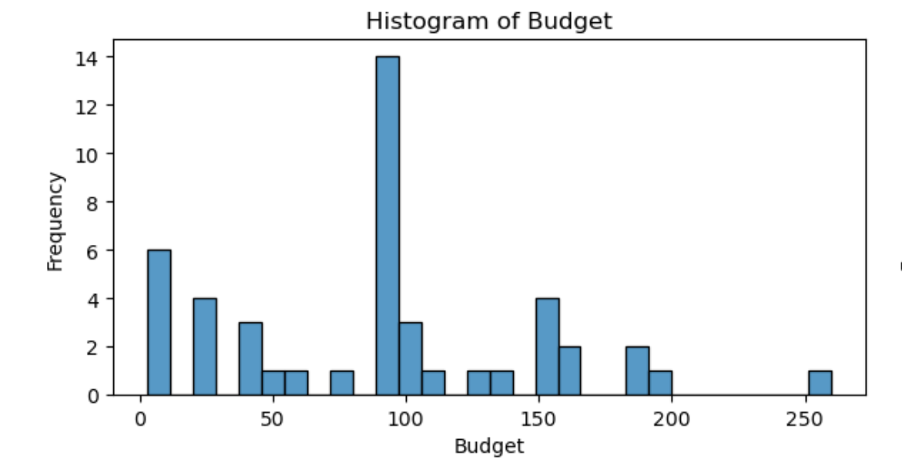
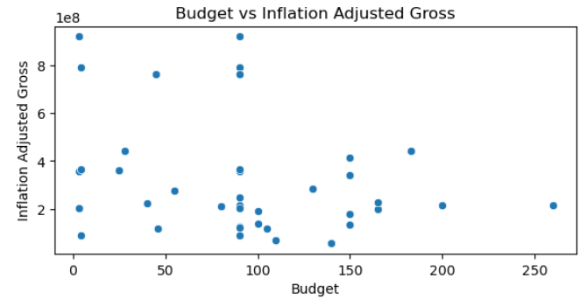
‘Budget’ Visualizations
Note: The outlier suggests that there was a movie that had a substantially larger budget than most.
This scatterplot shows us that there doesn’t appear to be a strong relationship between a films budget and the amount of money it makes.

Slide 8
‘Running Time’ Descriptive Statistics
Descriptive Statistics:
count 46.000000
mean 96.021739
std 15.781127
min 74.000000
25% 84.000000
50% 94.500000
75% 106.000000
max 129.000000
Name: Running time (int), dtype: float64

Slide 9
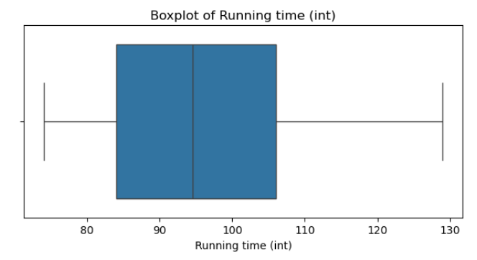
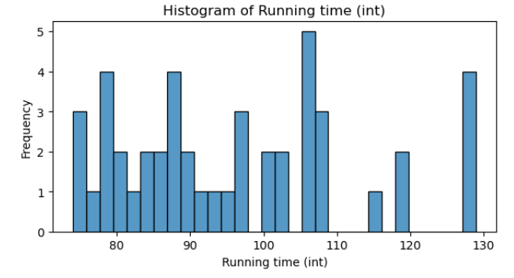
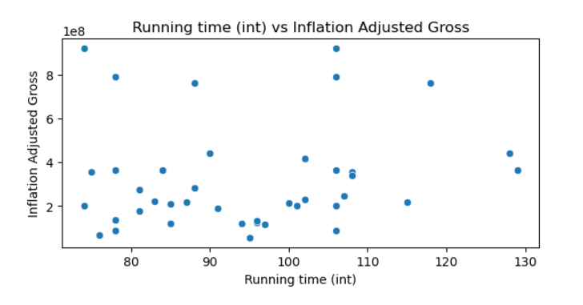
‘Running Time’ Visualizations
This scatterplot appears to show a slight correlation between running time and how much a film makes. It appears that most of the films are clustered around a lower run time and a lower amount made.

Slide 10
‘IMDB’ Descriptive Statistics
Descriptive Statistics:
count 46.000000
mean 7.386957
std 0.685276
min 5.300000
25% 6.900000
50% 7.400000
75% 8.000000
max 8.500000
Name: imdb, dtype: float64

Slide 11
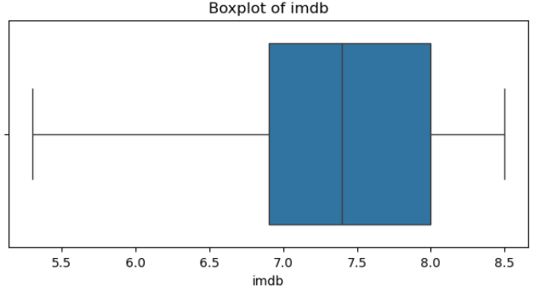
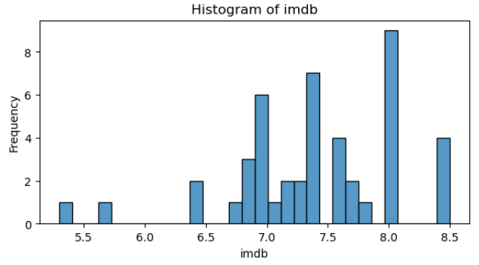
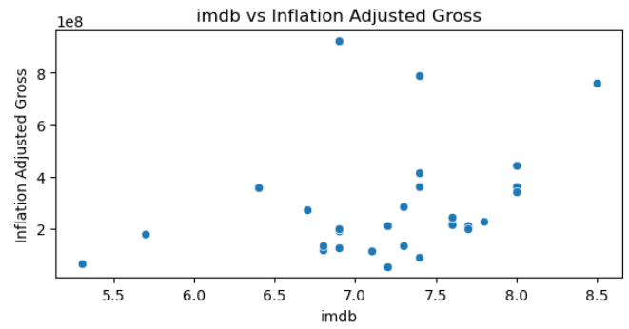
‘IMDB’ Visualizations
This scatterplot appears to show a very weakpositive correlation between the two variables. Potentially telling us that the higher rating on imdb the more money is makes.

Slide 12
‘Rotten Tomatoes’ Descriptive Statistics
Descriptive Statistics:
count 46.000000
mean 82.934783
std 16.745682
min 37.000000
25% 84.000000
50% 89.000000
75% 94.000000
max 98.000000
Name: rotten_tomatoes, dtype: float64

Slide 13
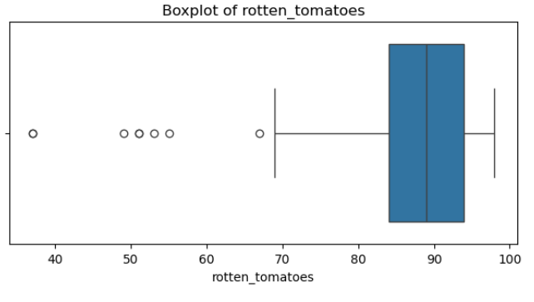
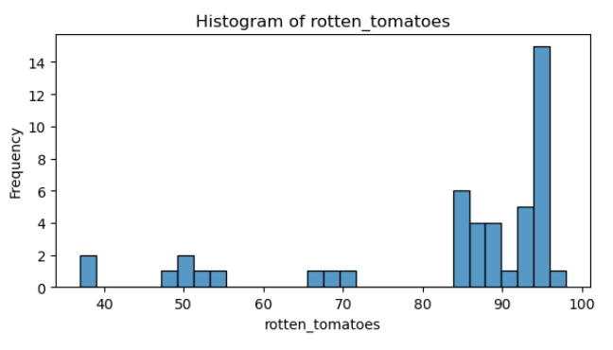
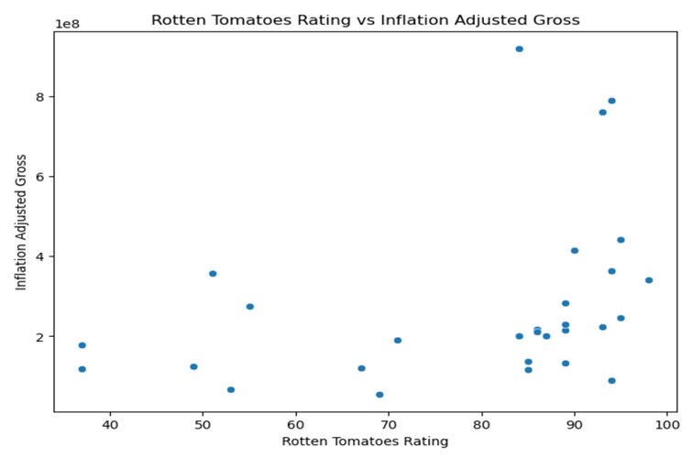
‘Rotten Tomatoes’ Visualizations
Note: There are quite a few outliers, which tell us that there were 6 movies that weren’t received very well by rotten tomatoes, which is unusual as most movies do receive a high rating.
The scatterplot suggests to us that it appears most of the of the films do make about the same money, but the ones with higher ratings are the ones that make more money.

Slide 14
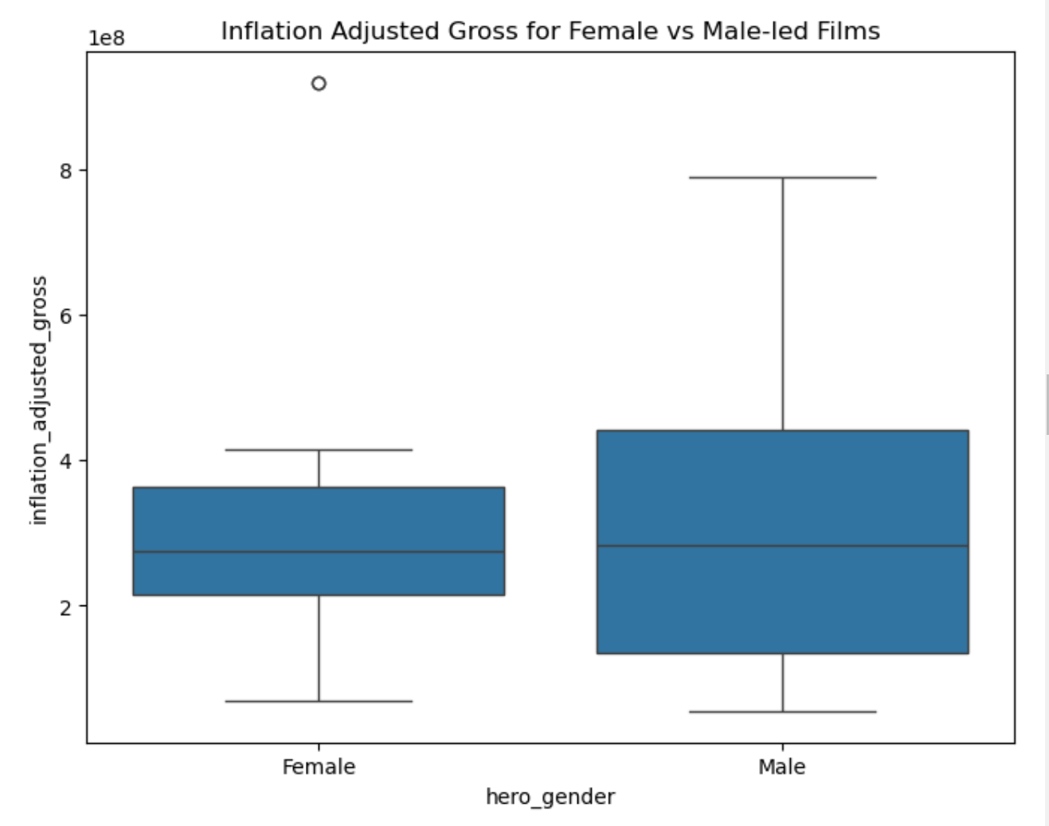
‘Hero Gender’ Variables
The analysis here is slightly different due to ‘hero_gender’ being a categorical variable.
Note: The extreme outlier in Female Led films. This outlier is because while most female-led films have made less money than the male-led films, there was one female-led film that outperformed by a lot.

Slide 15
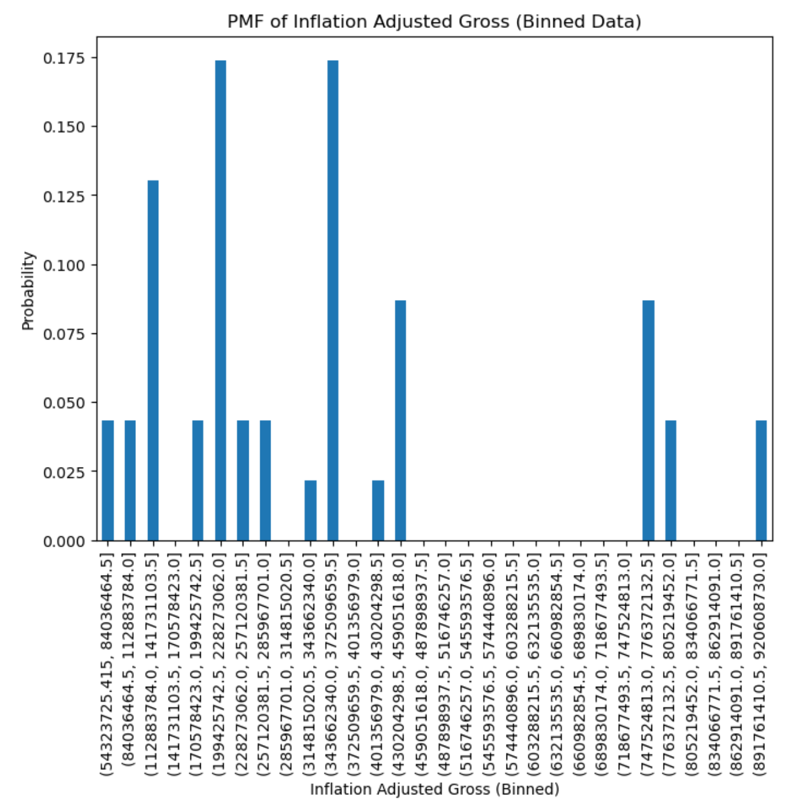
PMF (Probability Mass Function)
The PMF here shows us that there is a relatively low probability of observing very low or very high inflation-adjusted gross values. The probability increases the closer we are to the central bins.

Slide 16
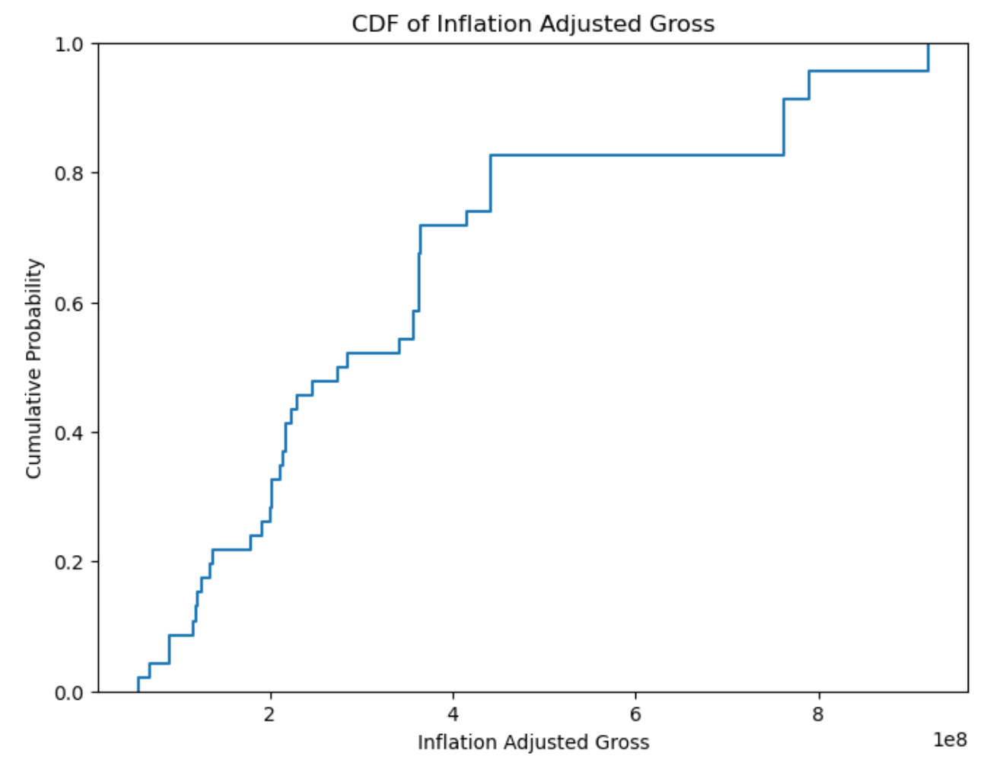
CDF (Cumulative Distribution Function)
This CDF shows us the probability of observing inflation-adjusted gross values below any given point. The overall shape suggests a right-skewed distribution, which implies that while a majority of values cluster near a central point, there is a significant probability of observing some much higher values.

Slide 17
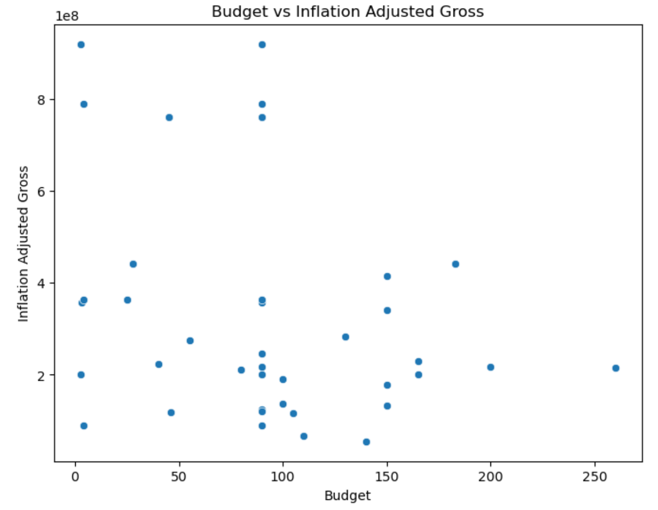

Comparing Scatterplots
These scatterplots suggest that there isn’t a strong correlation between either variable. When looking at Budget vs. Inflation Adjusted Gross there isn’t a clear line, but most points are clustered toward a lower budget and a central inflation adjusted gross. Meaning that most of the films do have a lower budget and make a middle amount. The second scatterplot between Rotten Tomatoes Ratings and Inflation Adjusted Gross also doesn’t have a clear line, but there is a bit more clustering. This scatterplot tells us that it appears most of the of the films do make about the same money, but the ones with higher ratings are the ones that make more money.
These charts lead us to believe that there isn’t really a correlation between the two variables, but we can still potentially see some trends.

Slide 18
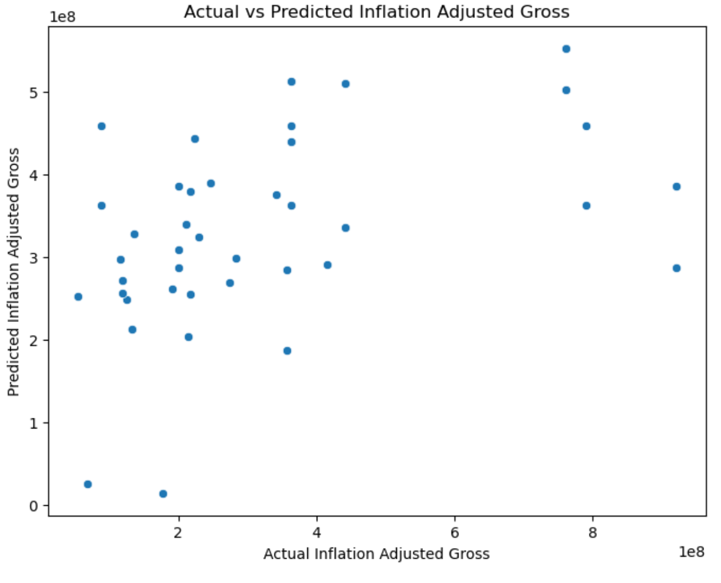
Regression Analysis
Intercept: -588367810.0871035
Coefficients: [-1.12422381e+06 1.28184338e+08 1.09741607e+06]

Slide 19
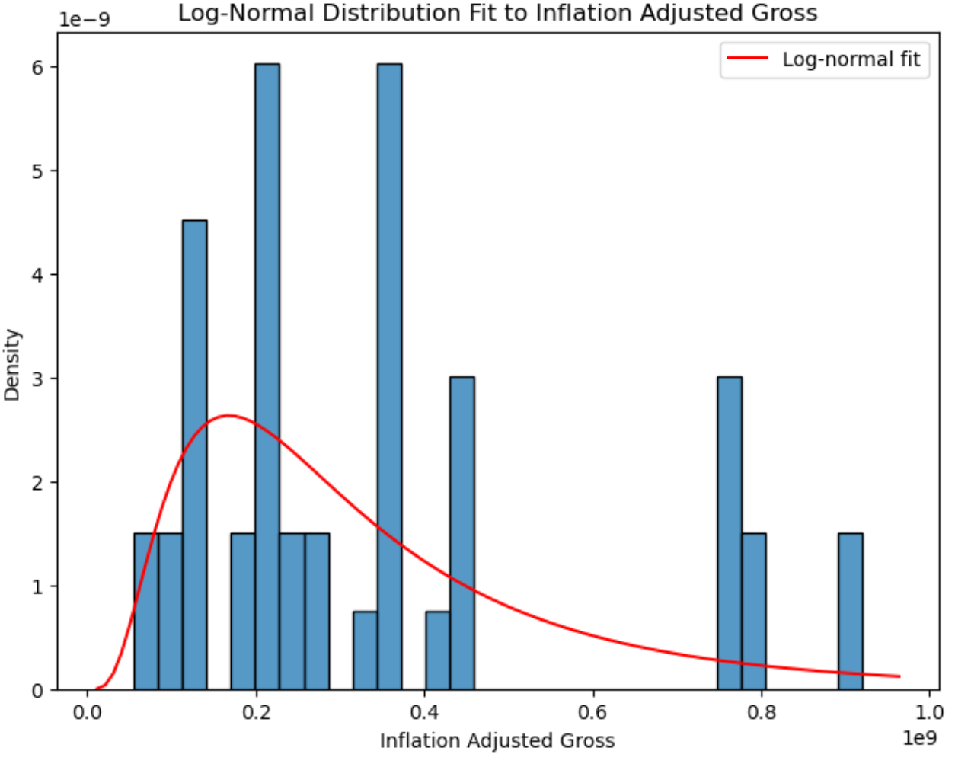
Log-Normal Distribution
This shows us that majority of the films make around the same amount of money, but there are a few that make significantly more which is causing a slight skew.

